Slide 1
Archaeological and Cultural Resources
CGPRT(W) : Ensuring Clean Seas and Coasts in Western Region ……

Slide 2
Objective
To understand the importance of adapting oil spill response techniques when in the presence of archeological and cultural resources.
CGPRT(W) : Ensuring Clean Seas and Coasts in Western Region ……

Slide 3
Resources
Archaeological resources and cultural resources may include:
Historic properties
Artefacts
Burial sites
Village sites
Shipwrecks
Shell middens
CGPRT(W) : Ensuring Clean Seas and Coasts in Western Region ……

Slide 4
Resources
Continued:
Religious sites
Historical documents
Cultural use of natural resources
Petroglyphs
Unsurveyed sites with high potential for the presence of archaeological or cultural resources
CGPRT(W) : Ensuring Clean Seas and Coasts in Western Region ……

Slide 5
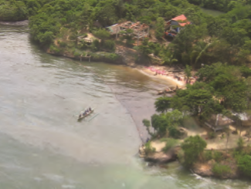
Resources
Indigenous peoples tended to live near water (which provided means of transport, water and food), areas which are often rich in archaeological and cultural resources include:
Coastal areas
River beds
Lakeshores
CGPRT(W) : Ensuring Clean Seas and Coasts in Western Region ……

Slide 6
Resource Identification
Pre-spill planning phase
  Contingency plans
  Resource maps
Response phase
  Implement contingency plans and review data
  Consult with experts
  Surveys to identify additional resources
  Consider best management practices to protect resources from shoreline treatment methods
CGPRT(W) : Ensuring Clean Seas and Coasts in Western Region ……

Slide 7
Pre-spill Planning Phase
Ideally these resources are identified in the contingency plan however it is important to understand that information on these resources may not be available for the planning phase due to confidentiality or for the protection of the resource from the public
CGPRT(W) : Ensuring Clean Seas and Coasts in Western Region ……

Slide 8
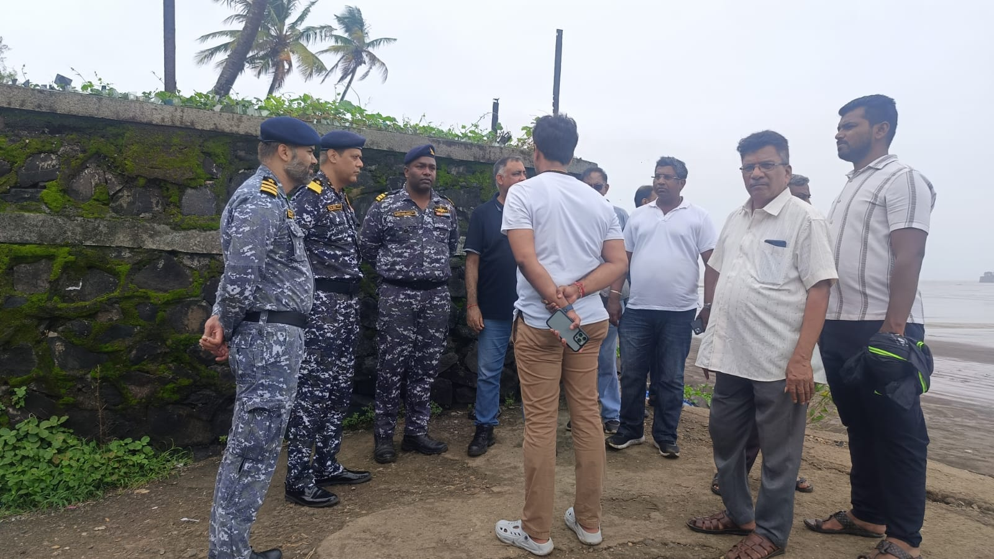
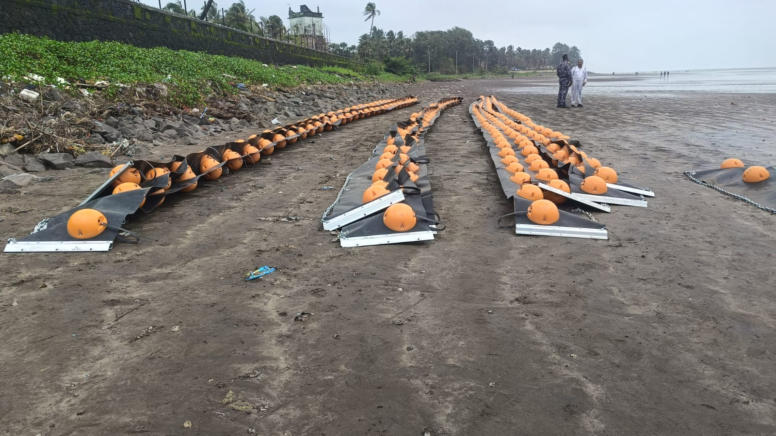
Pre-spill Planning Phase
CGPRT(W) : Ensuring Clean Seas and Coasts in Western Region ……

Slide 9
Response phase
Incident management needs reliable and timely data on these resources so response operations in the reactive phase do not mistakenly impact resources
Damaging these resources can be an extremely sensitive issue
NEBA must be considered when making decisions with respect to clean-up operations
CGPRT(W) : Ensuring Clean Seas and Coasts in Western Region ……

Slide 10
Response Phase
It is critical to ensure that the appropriate cultural resource specialists/appropriate regulatory agencies/aboriginal groups/ landowners are consulted
Local knowledge is an asset
Comply with appropriate regulations and permitting processes
CGPRT(W) : Ensuring Clean Seas and Coasts in Western Region ……

Slide 11
Response Phase
A clean-up-wide cultural resource policy should be implemented
Develop procedures for response personnel if evidence of a resource is detected
Archaeologists/cultural resource specialists are integrated on the SCAT teams as required
CGPRT(W) : Ensuring Clean Seas and Coasts in Western Region ……

Slide 12
Response Phase
Resource specialists can be used to
Report any resources identified during SCAT surveys
Inspect site prior to clean-up operations
Monitor during operational activities that could impact sites
Develop procedures for response personnel if evidence of a resource is detected
Communications with Operations is key to ensure resources are protected/reported
CGPRT(W) : Ensuring Clean Seas and Coasts in Western Region ……

Slide 13
Response Phase
Keeping site confidentiality is a challenge
Use shoreline segment numbers not site names or locations when dealing with the documentation to help protect locations
CGPRT(W) : Ensuring Clean Seas and Coasts in Western Region ……

Slide 14
Impact of Oil
Direct physical contact of oil with resources
may impact the ability to preserve a resource
contribute to its deterioration
result in the inability to radiocarbon date a resource causing loss of valuable scientific, historic and or cultural data
CGPRT(W) : Ensuring Clean Seas and Coasts in Western Region ……

Slide 15
Impact of Response Activities
Response activities may adversely impact resources so NEBA must be conducted
  Physical destruction, damage or alteration of a site
  Ground disturbing activities such as sediment removal, tilling, digging
  Shoreline cleaning agents, in situ burning
  Construction of access roads or paths for response crews/staging areas
CGPRT(W) : Ensuring Clean Seas and Coasts in Western Region ……

Slide 16
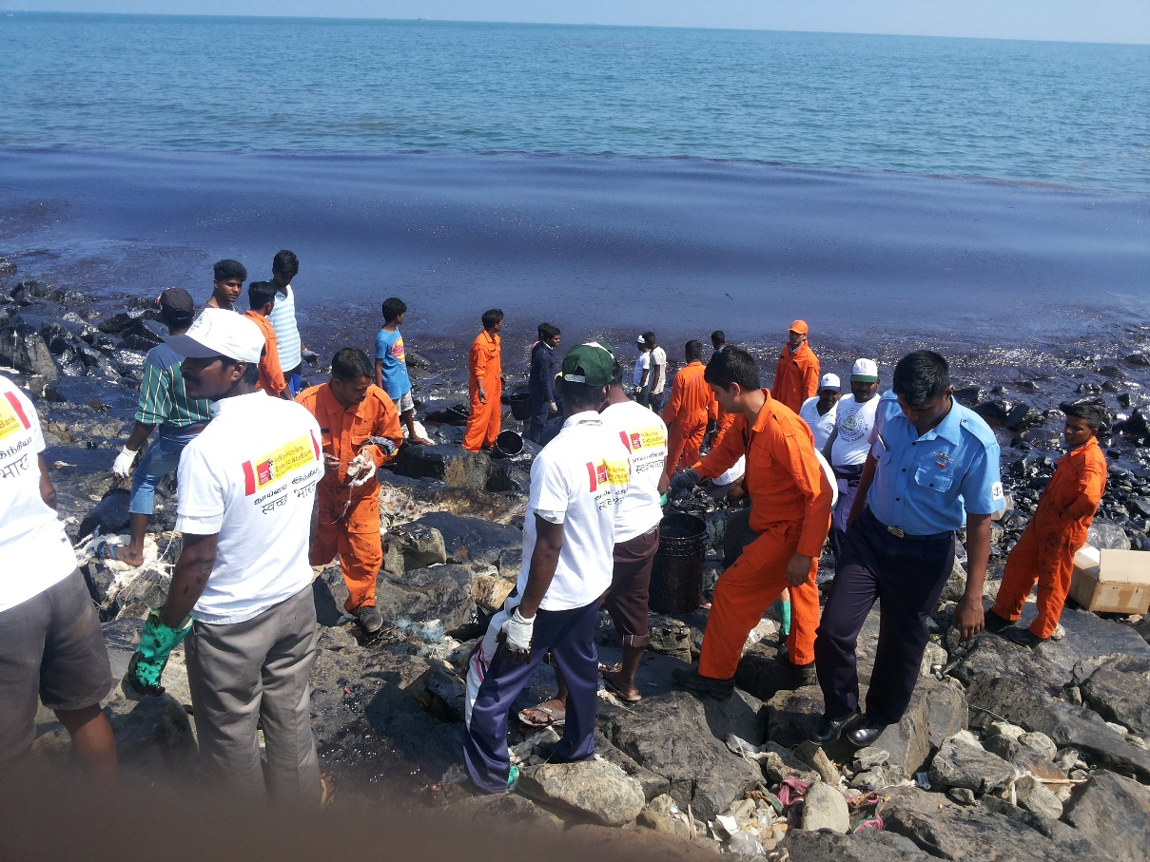
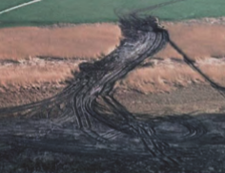
Impact of Response Activities
CGPRT(W) : Ensuring Clean Seas and Coasts in Western Region ……

Slide 17
Mitigating Impact
Shoreline clean-up may have to be modified/restricted to protect resources
Examples:
  Sensitive areas delineated
  Areas may have to be excluded from response activities entirely
  Ground disturbance may be limited to certain depths or areas
  Monitors checking each interval of ground disturbance
CGPRT(W) : Ensuring Clean Seas and Coasts in Western Region ……

Slide 18
Post-incident Operations
Post-spill studies that affect a resource may be necessary to:
  determine the nature and extent of damage
  assess and monitor the recovery processes
CGPRT(W) : Ensuring Clean Seas and Coasts in Western Region ……

Slide 19
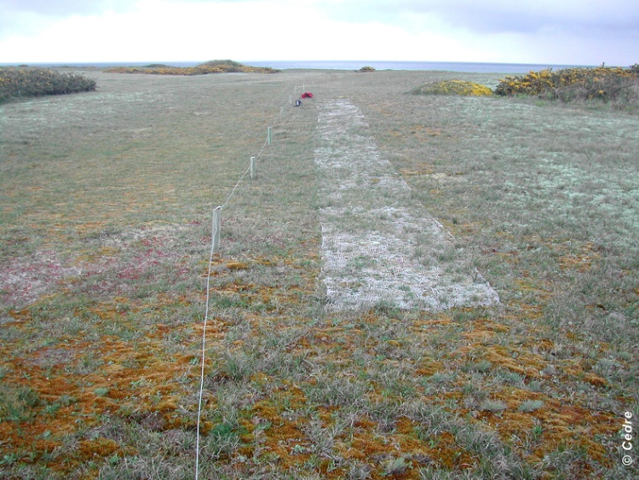
Post-incident Operation
Restoration
  Measures to speed up recovery from environmental damages
  Aim to bring back condition of a site or property to what it was prior to a spill
  May result in claims for compensation
Source: CEDRE
CGPRT(W) : Ensuring Clean Seas and Coasts in Western Region ……

Slide 20
Conclusion
Archaeological and cultural resources can be of major historical and cultural significance
It is important that incident management receive accurate and timely information regarding such resources in order to protect them where practicable
Clean-up activities may have to be modified or restricted to ensure resources are not adversely affected and NEBA must be conducted
Operations must be engaged in any policies and procedures
CGPRT(W) : Ensuring Clean Seas and Coasts in Western Region ……

Slide 21
Any questions?
CGPRT(W) : Ensuring Clean Seas and Coasts in Western Region ……

